Slide 1


CS-446: Information Systems Security
Lecture # 12: HTTPS: Goals and Pitfalls
Prof. Dr. Sufian Hameed
Department of Computer Science
FAST-NUCES

Slide 2
Overview
HTTPS
SSL/TLS Overview
HTTPS in the Browser
Problems with HTTPS and the Lock Icon

Slide 3
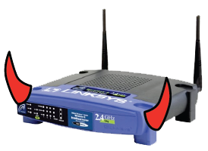
Threat Model: Network Attacker
Network Attacker:
Controls network infrastructure: Routers, DNS
Passive attacker: only eavesdrops on net traffic
Active attacker: eavesdrops, injects, blocks, and modifies packets
Examples:
Wireless network at Internet Café
Internet access at hotels (untrusted ISP)

Slide 4
SSL/TLS overview
Public-key encryption:
Alice
Bob
m
Enc
c
c
Dec
m
PK_{Bob}
SK_{Bob}
Bob generates (SK_{Bob} , PK_{Bob} )
Alice: using PK_{Bob} encrypts messages and only Bob can decrypt

Slide 5

Certificates
How does Alice (browser) obtain PK_{Bob} ?
Browser Alice
Server Bob
CA
choose
(SK,PK)
PK and
proof “I am Bob”
check
proof
PK_{CA}
PK_{CA}
SK_{CA}
issue Cert with SK_{CA} :
verify
Cert
Bob’s key is PK
Bob’s key is PK
Bob uses Cert for an extended period (e.g. one year)

Slide 6
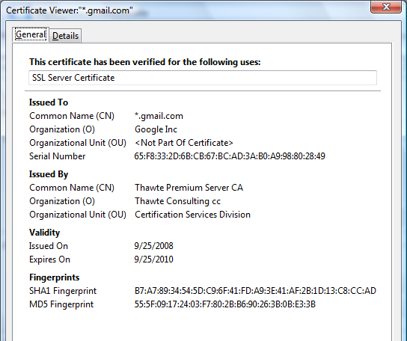
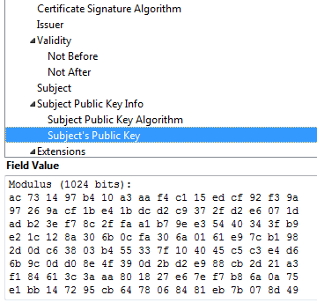
Certificates: example
Important fields:

Slide 7
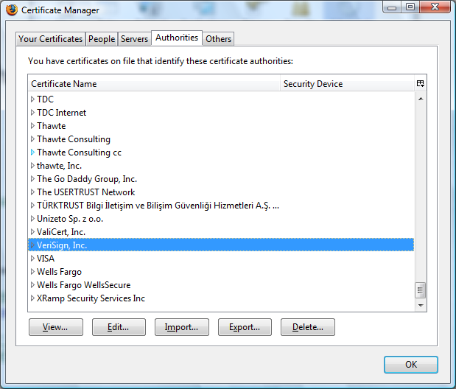
Certificate Authorities
Browsers accept certificates from a large number of CAs
top level CAs ≈ 600
Intermediate CAs ≈ 1200

Slide 8
Overview of TLS
Transport Layer Security (TLS) is a protocol that provides a secure channel between two communicating applications. The secure channel has 3 properties:
Confidentiality: Nobody other than the two ends of the channel can see the actual content of the data transmitted.
Integrity: Channel can detect any changes made to the data during transmission
Authentication: At least one end of the channel needs to be authenticated, so the other end knows who it is talking to.
Notes:
TLS evolved from its predecessor SSL and is gradually replacing SSL
When SSL was standardized by IETF, it was renamed to TLS
SSL version 3.0 was deprecated and replaced by TLS in June 2015
TLS is designed to run on top of TCP but can be implemented with other protocols such as UDP

Slide 9
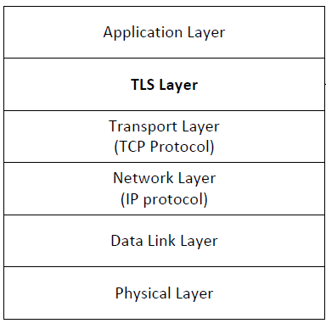
TLS Layer
TLS sits between the Transport and Application layer
Unprotected data is given to TLS by Application layer
TLS handles encryption, decryption and integrity checks
TLS gives protected data to Transport layer

Slide 10
TLS Handshake
Before a client and server can communicate securely, several things need to be set up first:
Encryption algorithm and key
MAC algorithm
Algorithm for key exchange
These cryptographic parameters need to be agreed upon by the client and server
This is the primary purpose of the handshake protocol

Slide 11
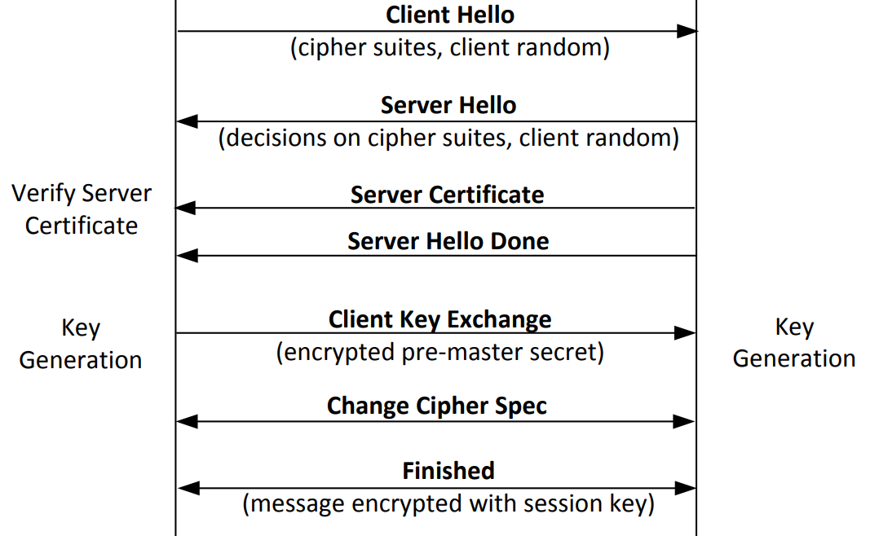
TLS Handshake Protocol
Notes:
Explanation in further slides

Slide 12
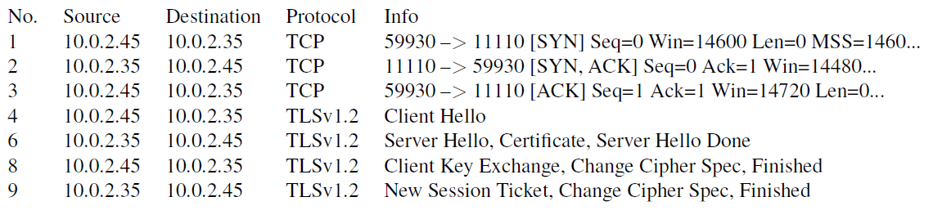
Network Traffics During TLS Handshake
Since TLS runs top of TCP, a TCP connection needs to be established before the handshake protocol. This is how the packet exchange looks between a client and server during a TLS handshake protocol captured using Wireshark:

Slide 13
Certificate Verification
The client first does a validation check of the certificate
Check expiration date, signature validity, etc.
Hostname and certificate’s common name match
The client needs to have the singing CA’s public-key certificate.
Notes:
Client programs, such as browsers, need to load a list of trusted CA certificated beforehand, or they will not be able to verify any certificate
If the signing CA is on the list, the certificate can be directly verified

Slide 14
Key Generation and Exchange
Although public-key algorithms can be used to encrypt data, it is much more expensive than secret-key algorithms.
TLS uses PKI for key exchange.
After that, server and client switch to secret-key encryption algorithm
The entire key generation consists of three steps:
Step 1: Generating pre-master secret
Step 2: Generating master secret
Step 3: Generating session keys

Slide 15
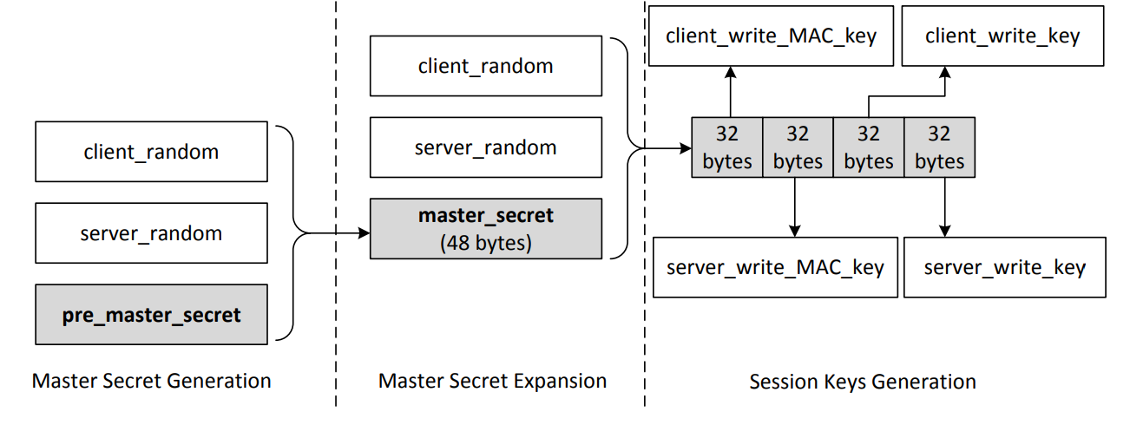
Key Generation and Exchange
These keys are used to protect an SSL session
Notes:
Pre master secret : The length of the number depends on the key exchange algorithm. Secret is encrypted with the servers public key and sent to the server.
Session keys: the client_write keys are used to secure the data from the client to the server which the server_write keys are used to secure data from the server to the client. The communication is bi-directional so both directions use separate keys.
The figure assumes we are using AES_256_CBC_SHA so each key is 32 bytes long

Slide 16
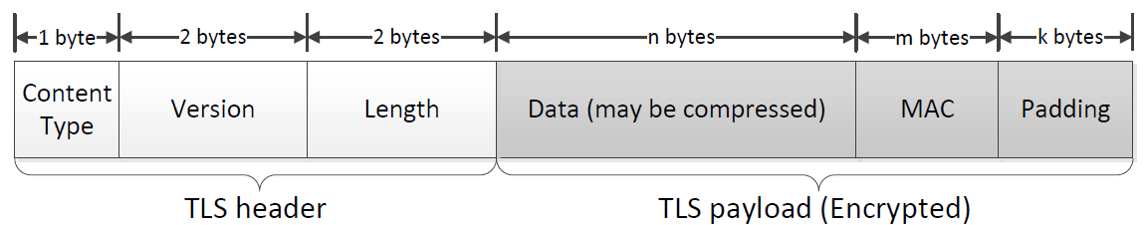
TLS Data Transmission
Once the handshake protocol is finished, client and server can start exchanging data.
Data is transferred using records.
Each record contains a header and a payload
Notes:
In this section, we focus on the application record type, which is used to transfer application data between a client and a server
Content Type: Indicates the type of protocol data carried by current record (handshake, alert, application, heartbeat or ChangeCipherSpec)
Version: This field identifies major and minor version of TLS being used
Length: The length of the payload field.

Slide 17
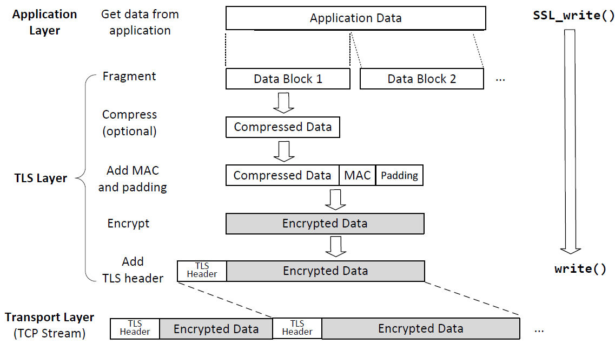
Sending Data with the TLS Record Protocol
Notes:
Applications invoke SSL_write() to send data over TLS.
This API breaks data into blocks and generates MAC for each block before encrypting the block
TLS puts the encrypted block into the payload field of the TLS record, and gives it to the transport layer for transmission

Slide 18
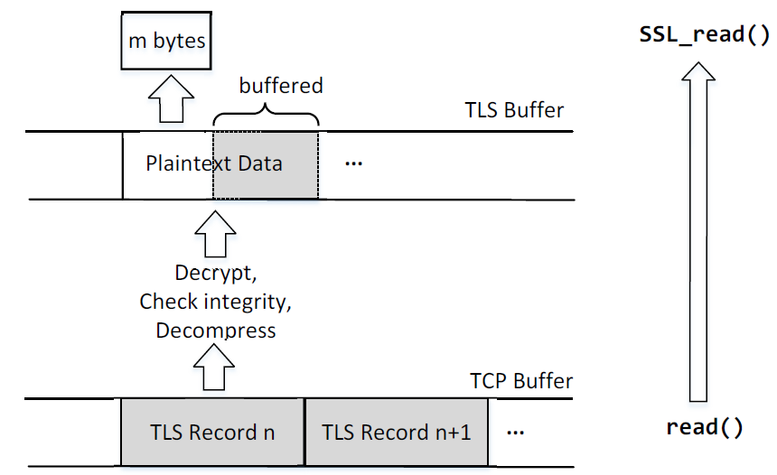
Receiving Data with the TLS Record Protocol
Notes:
Applications invoke SSL_read() to read data over TLS which calls the system read() to read one or multiple records from the TCP stream
After reading, the packet is decrypted, MAC is verified, data is decompressed (if needed) and then data is given to the application
When SSL_read() is called and TLS buffer is empty:
one TLS record is retrieved from the TCP buffer and processed
If the number of bytes is not enough to satisfy the request, another TLS record is retrieved.
This will repeat until the request is satisfied or no more data is available
If the total number of processed bytes exceeds the required number, leftover is stored in the TLS buffer for later read requests
When SSL_read() is called and TLS buffer is not empty:
TLS tries to get the requested amount of data from the TLS buffer
If the buffer contains enough data, TLS returns the required amount to the application
If the buffer does not contain enough data, TLS returns all the amount to the application

Slide 19
Integrating SSL/TLS with HTTP ⇒ HTTPS
web proxy
web server
Two complications
Web proxies
solution: browser sends CONNECT domain-name
before client-hello (dropped by proxy)
Virtual hosting
two sites hosted at same IP address.
solution in TLS 1.1: SNI (RFC 4366)
client_hello_extension: server_name=cnn.com
implemented since FF2 and IE7 (vista)
corporate network
web server
client-hello
server-cert ???
cert_{CNN}
cert_{FOX}
Notes:
SNI: server name indication
http://en.wikipedia.org/wiki/HTTP_tunnel
https://www.igvita.com/2011/12/01/web-vpn-secure-proxies-with-spdy-chrome/

Slide 20
Why HTTPS is not used for all web traffic?
Slows down web servers
Breaks Internet caching
ISPs cannot cache HTTPS traffic
Results in increased traffic at web site
Incompatible with virtual hosting (older browsers)
May. 2012: IE6 ≈ 6.7% (ie6countdown.com)

Slide 21
HTTPS in the Browser

Slide 22
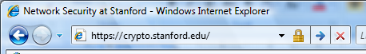
The lock icon: SSL indicator
Intended goal:
Provide user with identity of page origin
Indicate to user that page contents were not viewed or modified by a network attacker
In reality:
Origin ID is not always helpful
Company’s page can be hosted some where else
Many other problems (next few slides)
Notes:
Network attacker: controls routers, DNS; can inject, delete, and modify packets

Slide 23
When is the (basic) lock icon displayed
All elements on the page fetched using HTTPS
(with some exceptions)
For all elements:
HTTPS cert issued by a CA trusted by browser
HTTPS cert is valid (e.g. not expired)
CommonName in cert matches domain in URL

Slide 24
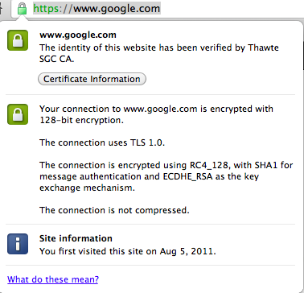
The lock UI: helps users authenticate site
uninformative

Slide 25

The lock UI: Extended Validation (EV) Certs
Harder to obtain than regular certs
requires human lawyer at CA to approve cert request
Designed for banks and large e-commerce sites
Helps block “semantic attacks”: www.bankofthevvest.com

Slide 26
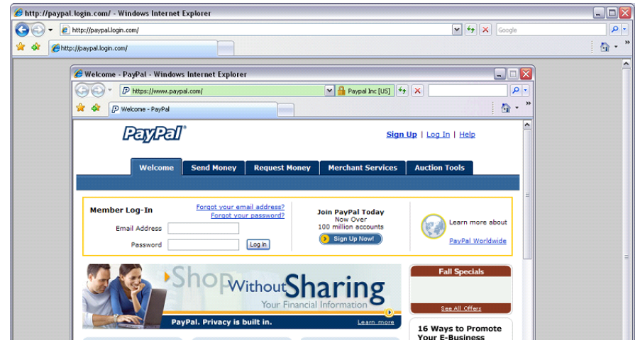
A general UI attack: picture-in-picture
Trained users are more likely to fall victim to this [JSTB’07]
Notes:
Both inner and outer windows are focused

Slide 27
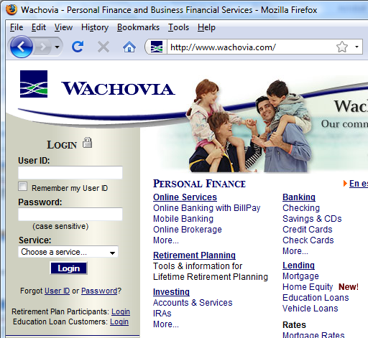
HTTPS and login pages: incorrect version
Users often land on login page over HTTP:
Type site’s HTTP URL into address bar, or
Google links to the HTTP page
View source:
<form method="post"
action="https://onlineservices.wachovia.com/..."
Notes:
User has no way to tell that his password is sent over HTTPS to site. Also has no way to tell that page wasn’t modified enroute (e.g. change form action).
Note the confusing lock next to “LOGIN” that suggests this is HTTPS.

Slide 28
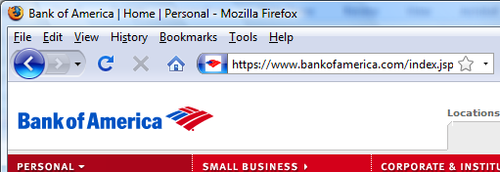
HTTPS and login pages: guidelines
General guideline:
Response to http://login.site.com should be Redirect: https://login.site.com

Slide 29
Problems with HTTPS and the Lock Icon

Slide 30
Problems with HTTPS and the Lock Icon
Upgrade from HTTP to HTTPS
Semantic attacks on certs
Invalid certs and forged certs
Certificate Issuance Woes
Mixed content
HTTP and HTTPS on the same page
Does HTTPS hide web traffic?

Slide 31
1. HTTP → HTTPS upgrade
Common use pattern:
browse site over HTTP; move to HTTPS for checkout
connect to bank over HTTP; move to HTTPS for login
Easy attack: prevent the upgrade (ssl_strip) [Moxie’08]
<a href=https://…> ⇒ <a href=http://…>
Location: https://... ⇒ Location: http://... (redirect)
<form action=https://… > ⇒ <form action=http://…>
HTTP
SSL
attacker
web server
Notes:
ssl_strip: prevents browser from upgrading, but does the SSL upgrade when communicating with the server. Server has no idea this is taking place.

Slide 32
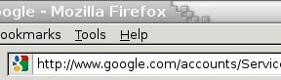
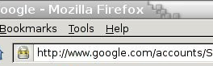
Tricks and Details
Tricks: drop-in a clever fav icon (older browsers)
Details:
Erase existing session and force user to login:
ssl_strip injects “Set-cookie” headers to delete existing session cookies in browser.
⇒

Slide 33
Defense: Strict Transport Security (HSTS)
web server
Strict-Transport-Security max-age=31⋅10⁶;
Header tells browser to always connect over HTTPS
After first visit, subsequent visits are over HTTPS
self signed cert results in an error
STS flag deleted when user “clears private data” (chrome)
Compromise: security vs. privacy
Notes:
max-age is given in seconds (31.10^6) is one year.

Slide 34
2. Semantic attacks on certs
International domains: xyz.cn
Rendered using international character set
Observation: Chinese character set contains chars that look like “/” and “?” and “.” and “=”
Attack: buy domain cert for *.badguy.cn
setup domain called:
www.bank.com/accounts/login.php?q=me.badguy.cn
note: single cert *.badguy.cn works for all sites
Extended validation (EV) certs may help defeat this

Slide 35
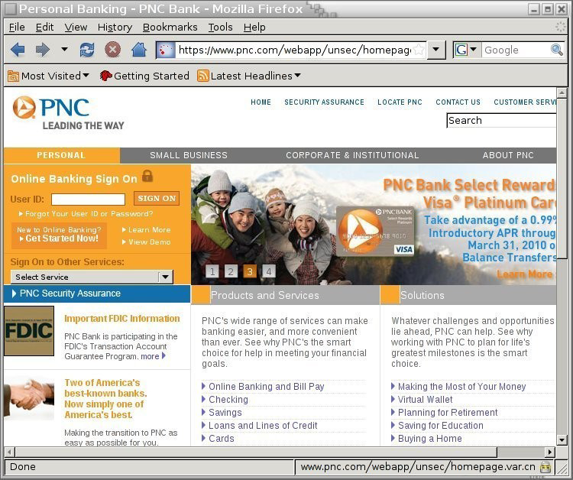

Slide 36
3. Invalid certs
Examples of invalid certificates:
expired: current-date > date-in-cert
CommonName in cert does not match domain in URL
unknown CA (e.g. self signed certs)
Small sites may not want to pay for cert
Users often ignore warning:
Is it a mis-configuration or an attack? User can’t tell.
Accepting invalid cert enables man-in-middle attacks (see http://crypto.stanford.edu/ssl-mitm )

Slide 37
Man in the middle attack using invalid certs
GET https://bank.com
BadguyCert
BankCert
attacker
ClientHello
ClientHello
bank
ServerCert (Badguy)
ServerCert (Bank)
bad cert
warning!
SSL key exchange
SSL key exchange
k₁
k₁
k₂
k₂
HTTP data enc with k₁
HTTP data enc with k₂
Attacker proxies data between user and bank. Sees all traffic and can modify data at will.

Slide 38
Statistics
25% of active web sites support HTTPS (port 443)
Only 3% of HTTPS sites have proper cert:
For 97% of sites domain name does not match Common Name in cert
Source: Qualys, June 2010

Slide 39
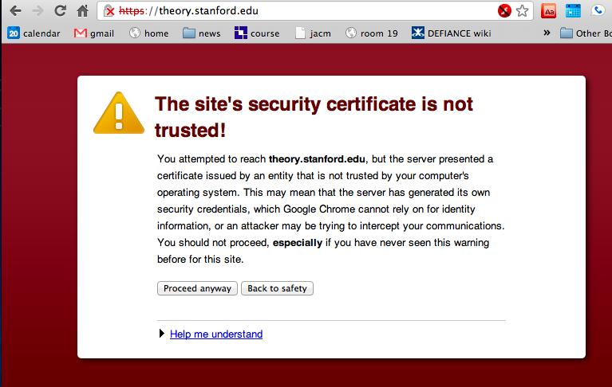
Invalid cert dialog
A difficult security prompt: user wants to proceed and doesn’t understand warning

Slide 40
4. Certificate Issuance Woes
Wrong issuance:
2011: Comodo and DigiNotar RAs hacked, issue certs for Gmail, Yahoo! Mail, …
Rogue CA:
2009: Etisalat CA in UAE
Signs software patch on behalf of RIM
PacketForensics: HTTPS MiTM for law enforcement
(see also crypto.stanford.edu/ssl-mitm )
⇒ enables eavesdropping w/o a warning in user’s browser
Notes:
Etisalat: cert. issued by Cybertrust

Slide 41
5. Mixed Content: HTTP and HTTPS
Page loads over HTTPS, but contains content over HTTP
(e.g. <script src=“http://.../script.js> )
Active network attacker can hijack session
Modifies script en-route to browser

Slide 42
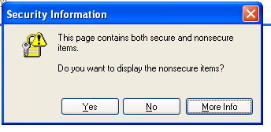
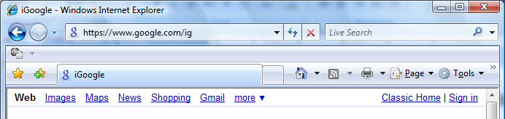
Mixed Content: HTTP and HTTPS
IE7:
Chrome:
No SSL lock in address bar:

Slide 43
7. Peeking through SSL
Network traffic reveals length of HTTPS packets TLS supports up to 256 bytes of padding
AJAX-rich pages have lots and lots of interactions with the server
These interactions expose specific internal state of the page
BAM!
Side-Channel Leaks in Web Applications Chen, Wang, Wang, Zhang, 2010

Slide 44
Acknowledgements
Material in this lecture are taken from the slides prepared by:
Prof. Dan Boneh (Stanford)

